Slide 1
CSC2210 OPERATING SYSTEMS I
Introduction to Operating systems

Slide 2
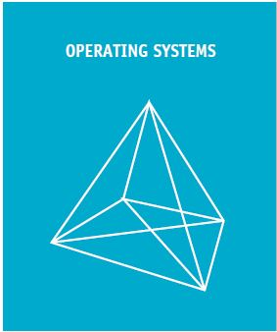

Slide 3
Introduction
To understand an operating system is to begin to understand the workings of an entire computer system, because the operating system software manages each and every piece of hardware and software

Slide 4
Definition
A computer system typically consists of software (programs) and hardware components.
The operating system software is the chief piece of software, the portion of the computing system that manages all of the hardware and all of the other software. The operating system controls every file, every device, every section of main memory, and every moment of processing time. It controls who can use the system and how.

Slide 5
Definition Contd.
Operating system can also be defined as a program that manages the computer hardware, provides a basis for application programs and acts as an intermediary between the computer user and the other computer hardware.

Slide 6
Variation of Operating Systems
Mainframe OS are designed to optimize utilization of hardware.
Personal Computer OS are designed to support complex games, business applications and everything in between.
OS for hand held computers are designed to provide an environment in which a user can easily interface with the computer to execute programs.
Thus, some operating systems are designed to be convenient , others to be efficient and others some combination of the two.

Slide 7
Roles of the operating system
Each time the user sends a command, the operating system must make sure that the command is executed, or if it’s not executed, it must arrange for the user to get a message explaining the error.
Note: this doesn’t necessarily mean that the operating system executes the command or sends the error message—but it does control the parts of the system that do.

Slide 8
Roles of the operating system contd.
An operating system is similar to government, it perform no useful functions by itself. It only provides an environment within which other programs can do useful work.

Slide 9
Components of operating system
Operating systems are made up of four or five major components (manager) depending on whether it is a networked or non-networked OS.
These managers forms the base of the pyramid.
At the base of the pyramid are the four essential managers of every major operating system: the Memory Manager, Processor Manager, Device Manager, and File Manager.
Each manager works closely with the other managers as each one performs its unique role. At the top of the pyramid is the User Interface, which allows the user to issue commands to the operating system.

Slide 10
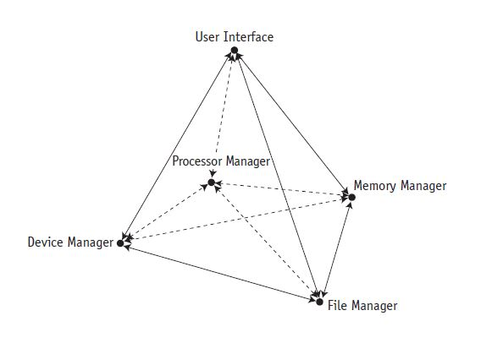
Non-networked operating system

Slide 11
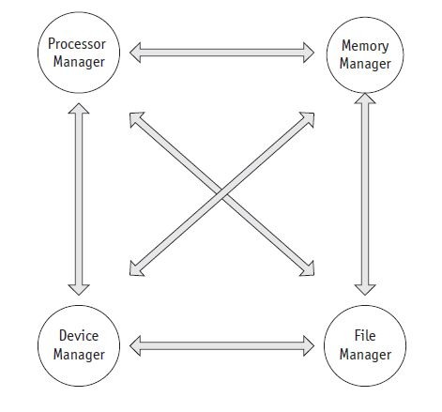

Slide 12
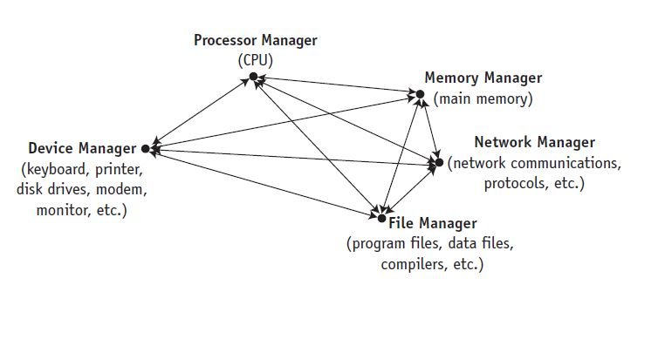
Networked systems with a Network Manager

Slide 13
The OS managers
The Memory Manager is in charge of main memory, also known as RAM
The Processor Manager decides how to allocate the central processing unit (CPU).
The Device Manager monitors every device, channel, and control unit. Its job is to choose the most efficient way to allocate all of the system’s devices, printers, ports, disk drives, and so forth, based on a scheduling policy chosen by the system’s designers.
The File Manager (the subject of Chapter 8) keeps track of every file in the system, including data files, program files, compilers, and applications.

Slide 14
The OS managers contd.
Operating systems with Internet or networking capability have a Network Manager that provides a convenient way for users to share resources while controlling users’ access to them.
The user interface is the portion of the operating system that users interact with directly

Slide 15
The OS managers contd.
Regardless of the size or configuration of the system, the managers must, at a minimum, perform the following tasks while collectively keeping the system working smoothly:
Monitor the system’s resources
Enforce the policies that determine what component gets what resources, when, and how much
Allocate the resources when appropriate
Deallocate the resources when appropriate

